Slide 2
A Tale of Two Physicians
Get 2 stock photos

Slide 3


Slide 4
Backstory
Debt
Saving
Investing
Roadmap

Slide 5
HAPPINESS IN RETIREMENT
HEALTH
WEALTH
RELATIONSHIPS&
DEPTH OF FREIENDSHIPS

Slide 6
Backstory: Money Scripts
MONEY
AVOIDANCE
MONEY
WORSHIP
MONEY
STATUS
MONEY
VIGILANCE

Slide 7

Jennifer Frahm
Economics BS- Purdue
JD- Indiana University
Tax Attorney
Registered Investment Advisor,
Series 6, 7, 63, 65

Slide 8
Jennifer Frahm
Economics BS
IU- JD
Tax Attorney
Registered Investment Advisor,
Series 6, 7, 63, 65
Investment Education
Hospital systems: IL/IN
Physician trust
Middle School: Finance Curriculum
Frugal Farm Girl

Slide 9

Wealth accumulation hurdles for physicians
Student loan debt Status Markers & Lifestyle Creep
Lost decade: 20’s
High Income Taxes: 32-37%

Slide 10
NET WORTH FORMULA
Assets – Debts = Net Worth
ASSETS
Checking/savings
Stocks/bonds
Home Market Value
Car Market Value
DEBTS
Student Loan
Credit Card Balan
Mortgage
Car Loan
-
=
NET
WORTH
Notes:
Dr that wants to retire by 50, accumulate as much as possible and move back to his homeland that has a much lower cost of living

Slide 11
Physician Expected Net Worth Formula:
Salary x Years in practice x 0.3 - $200,000
($200,000 salary) x (5 years in practice) x (.3) - $200,000
= $100,000
White Coat Investor, Chapters 2 and 6

Slide 12

DEBT
HOUSE, CARS, STUDENT LOANS

Slide 13



Appreciating Assets
Vs
Depreciating Assets

Slide 14

REAL ESTATE
Location
Family, circle of friends
Higher cost of living: CA, NYC, Chicago
Notes:
-It may sound like an overdone phrase but it still has meaning:
Location will the LARGEST factor determining the VALUE of your home both now and in the future. Examples: two identical houses one in the middle of the block or one on the corner. A single family home in a single family home area vs an area with condos or townhomes will have a greater value (not to say condos are bad).
-When deciding what you “need vs what you want” in a home sometimes it makes sense to settle for what you need I a desirable location for resale value.
VALUE ISN’T THE ONLY IMPORTANT CONSIDERATION
-You need to consider the impact living in another part of the country, the difficulty of uprooting and relocating, the weather, cost of living, and being far from family and friends (family and friends make life easier especially if children are involved). Do you want to use your vacation time to go visit family or take a real vacation?
-Doctors and lawyers don’t relocate as much as other industries, because they’ve established their client base so once you decide to move you may be there for the long haul.
-If all your family and friends are in Chicago or San Francisco, and this is where you want to be, know that a locale with a higher cost of living will have an impact of your ability to save and retire early.
-If you are still deciding on your location, check out a cost of living calculator…

Slide 15
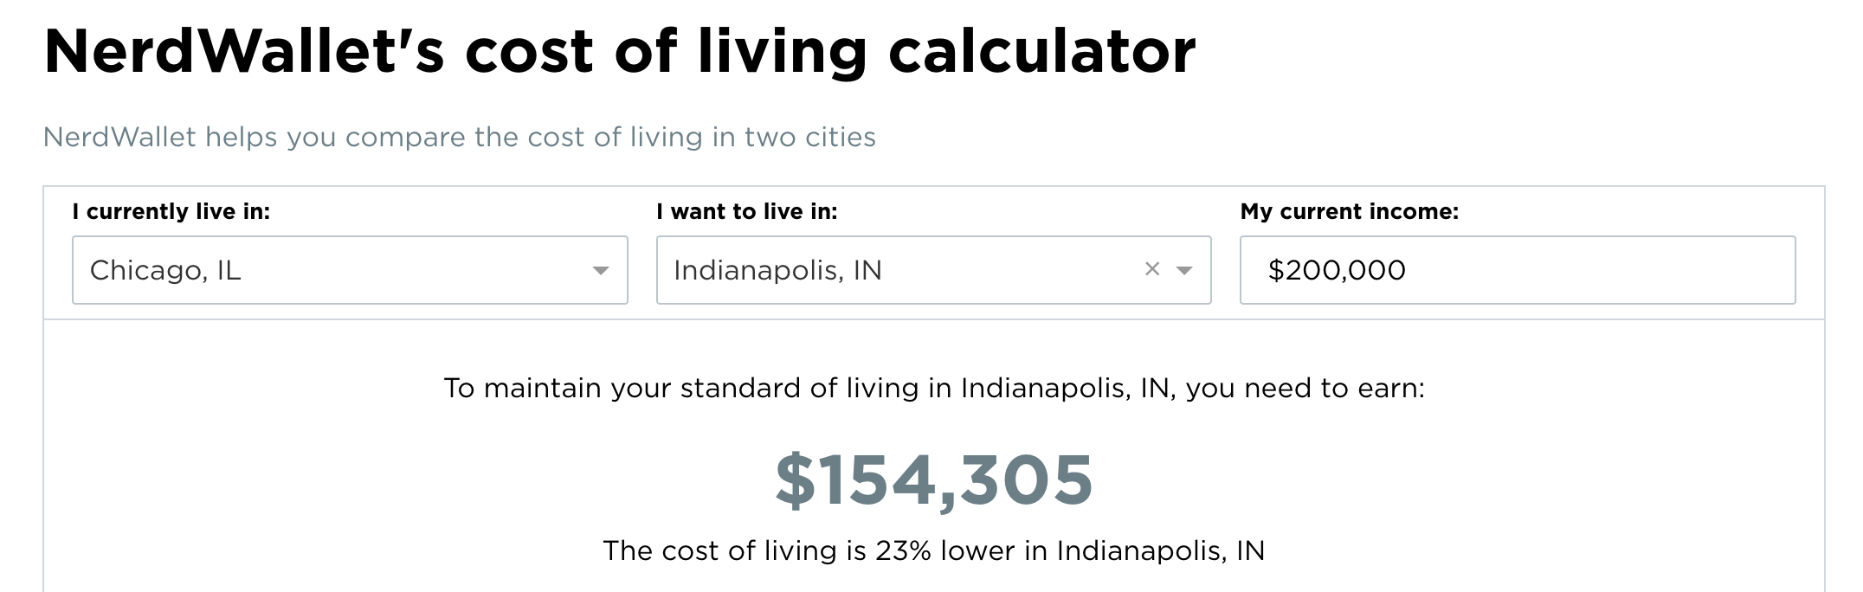
REAL ESTATE- Cost Considerations
Cost of living Calculator:
https://www.nerdwallet.com/cost-of-living-calculator
Notes:
You can see here that if you were comparing two job offers in Chicago and Indianapolis, the difference in cost of living makes these two salaries comparable: $154,305 in Indianapolis is comparable to $200,000 in Chicago.
This cost of living calculator is at nerdwallet.com/cost-of-living-calculator

Slide 16
REAL ESTATE GAME PLAN
Rent for a year or two, OR
Buy Starter Home OR
Purchase dream home using a physician loan

Slide 17

REAL ESTATE- The Budget
Spend less than 25% of your gross income on housing, including PITI
You can afford the house if:
20% down payment
pay off the house in 15 years

Slide 18
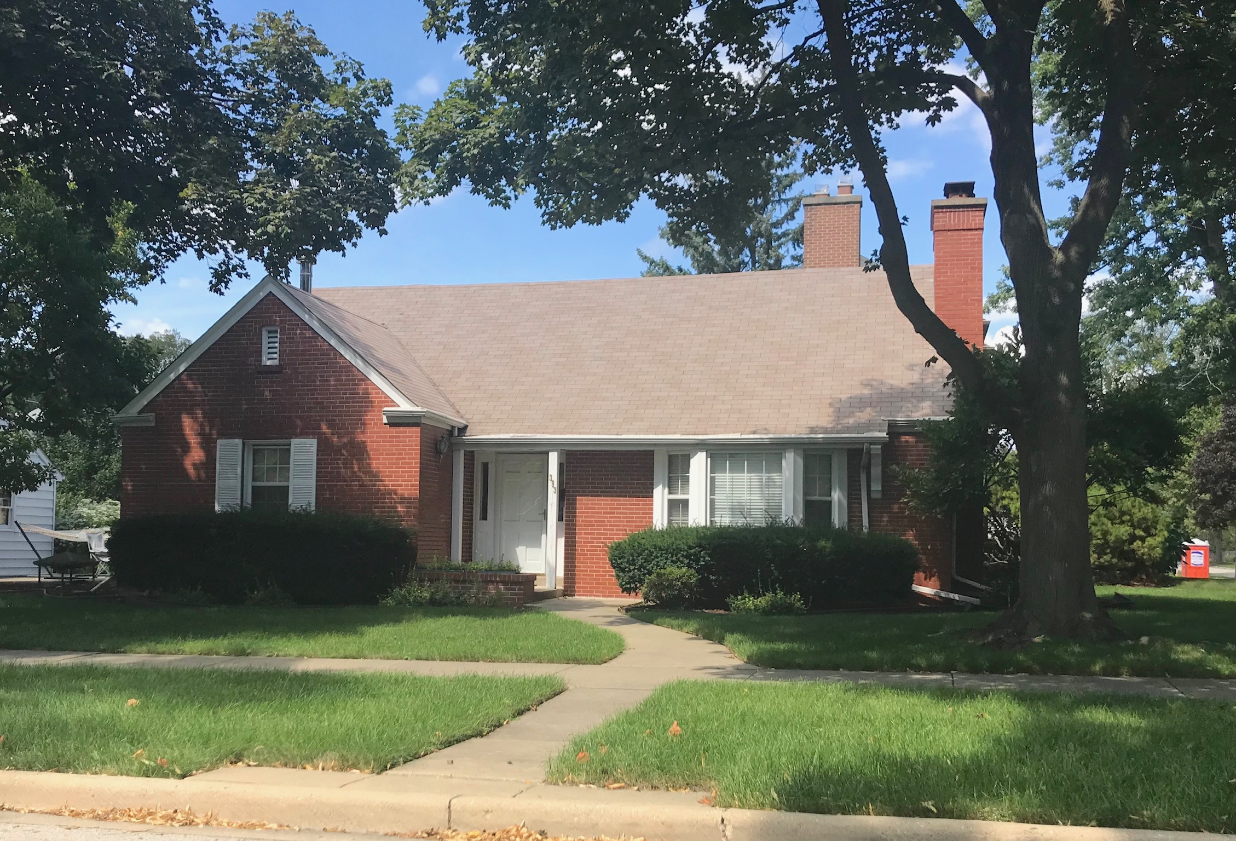

1. Rent & Research
1-2 years
Neighborhoods and schools
Job- a good fit?
Save 20% down payment

Slide 19

2. Buy Starter Home
Only if 20% down payment & stay for 4+ years

Slide 20
2. Buy Starter Home
PMI
Sell and use equity as 20% on dream home
Keep as a rental
or

Slide 21

3. Physician Mortgage
No money down/No PMI
Borrow up to $650,000
Student Loans excluded from debt ratio

Slide 22

Cars: Appreciating or Depreciating Asset?
BE SMARTER THAN THE MARKETING

Slide 23
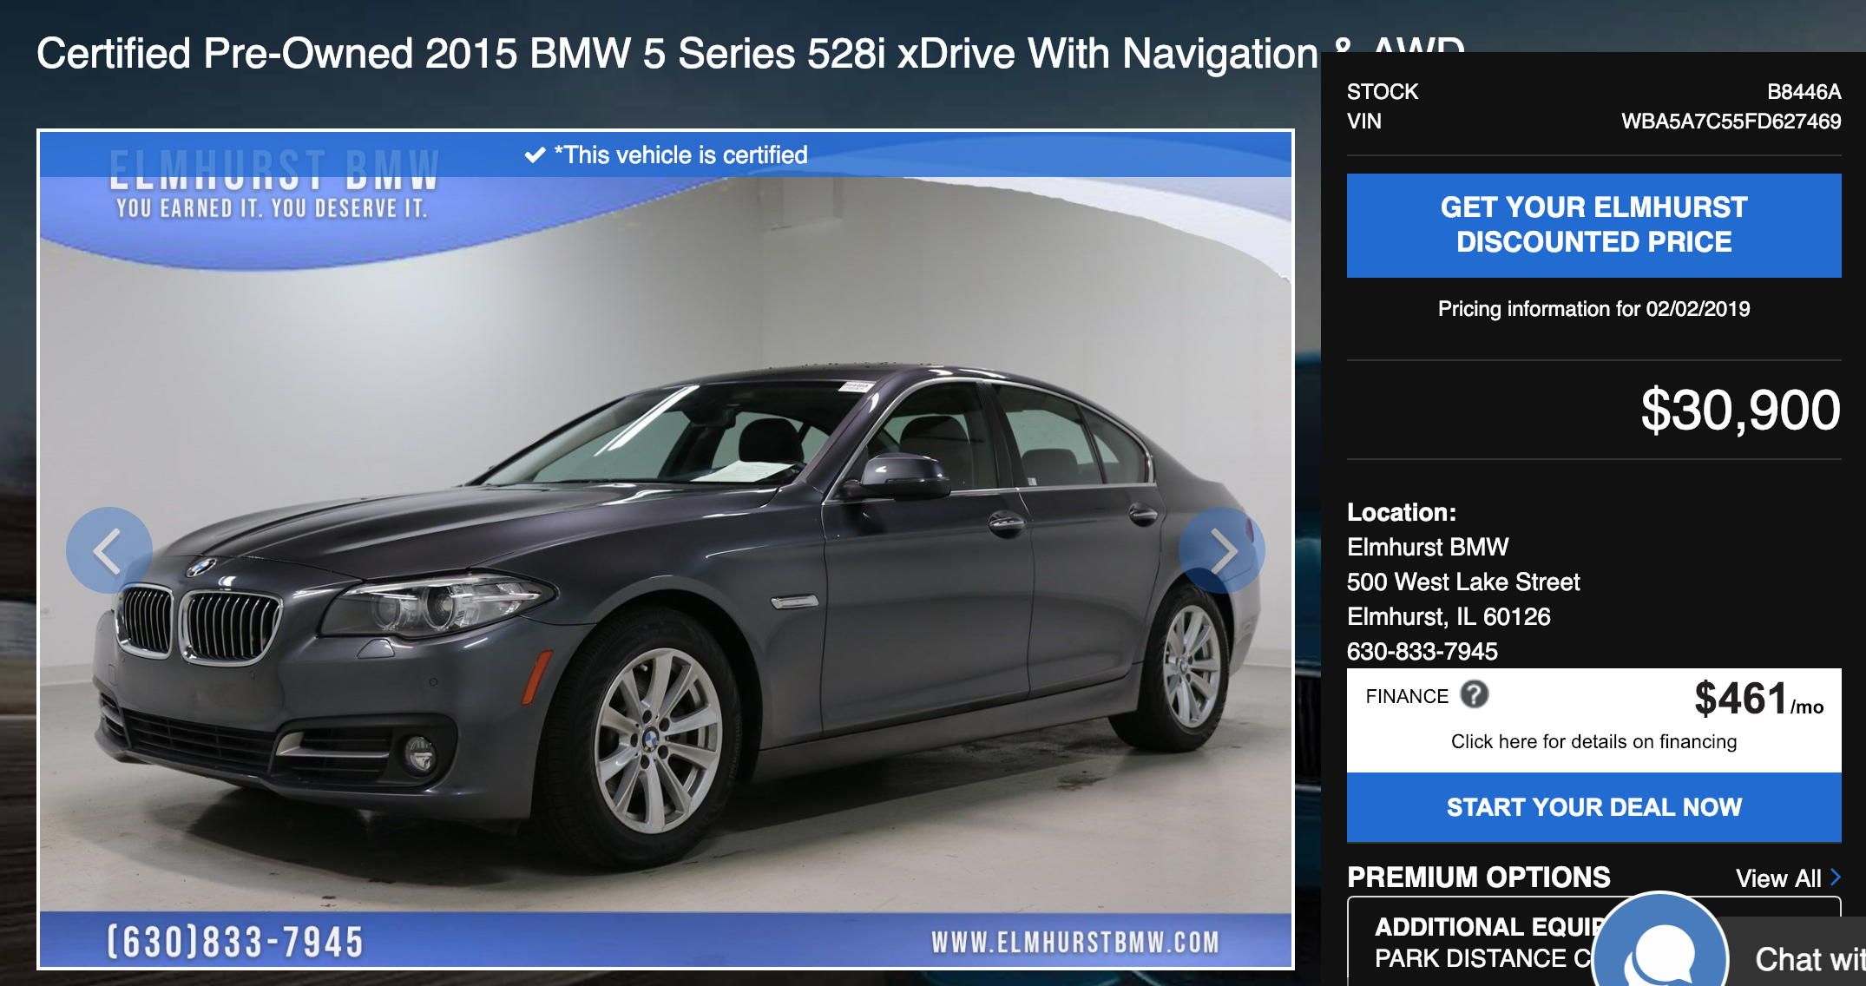
“Experienced” BMW with 22,500 miles

Slide 24
Student Loans
PAYE, REPAYE, IBR
Public Service Loan Forgiveness program (PSLF)
Save aggressively just in case.
864 ~ 1%, 2017-2019
Pay off loans as soon as possible.
Payoff goal =
5 years.
*HR 529

Slide 25
PSLF borrowers in que
(8 to 10 years): 1,724 - Estimated Forgiveness 2019 to 2021
(6 to 8 years): 10,428 - Estimated Forgiveness 2021 to 2023
(4 to 6 years): 45,235 - Estimated Forgiveness 2023 to 2025
(2 to 4 years): 147,686 - Estimated Forgiveness 2025 to 2027
(up to 2 years): 413,922 - Estimated Forgiveness 2027 to 2029
https://www.forbes.com/sites/robertfarrington/2019/01/22/why-the-public-service-loan-forgiveness-headlines-are-misleading/#5512a4ba1df0

Slide 26
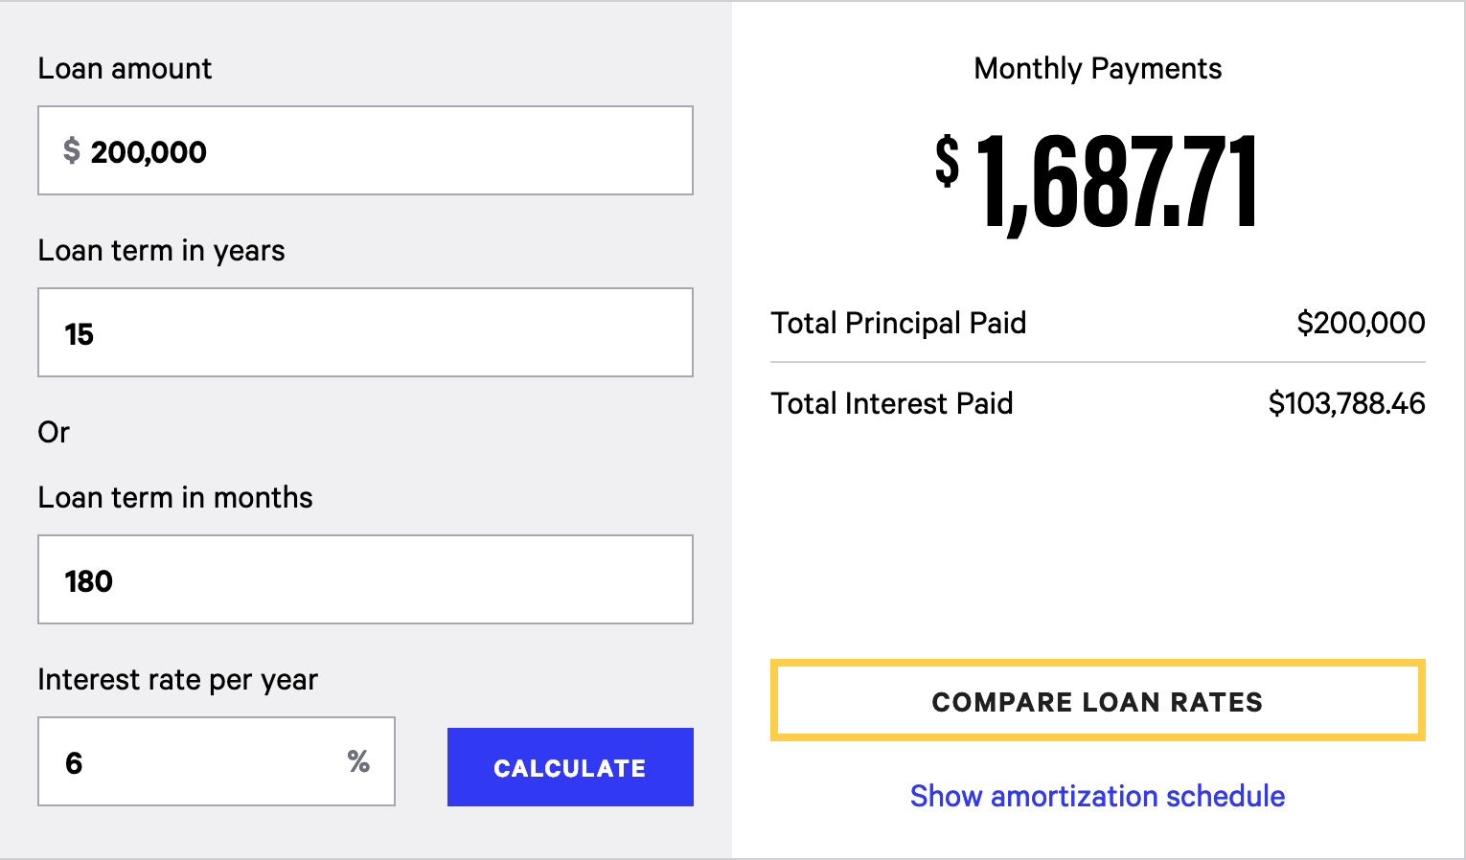
Debt: Where Compounding Interest Works AGAINST You
https://www.bankrate.com/calculators/college-planning/loan-calculator.aspx
Notes:
200,000 x 6% = $12,000 interest a year
150,000 x 6% = 9,000
100,000 x 6 = 6,000
50,000 x 3000= 3000
total of $30,000 interest 29% of the interest paid

Slide 27

Compounding Interest (Secret Weapon of Wealth Accumulation)

Slide 28

Would you rather….
Have 1 penny doubled each day for 29 days,
or $1,000,000?

Slide 29
100% Return Compounded Daily
$ 0.01
$ 0.02
$ 0.04
$ 0.08
$ 0.16
$ 0.32
$ 0.64
$ 1.28
$ 2.56
$ 5.12
$ 10.24
$ 20.48
$ 40.96
$ 81.92
$ 163.84
Day 16
Day 17
Day 18
Day 19
Day 20
Day 21
Day 22
Day 23
Day 24
Day 25
Day 26
Day 27
Day 28
Day 29
Day 30
Day 1
Day 2
Day 3
Day 4
Day 5
Day 6
Day 7
Day 8
Day 9
Day 10
Day 11
Day 12
Day 13
Day 14
Day 15
$ 327.68
$ 655.36
$ 1,310.72
$ 2,621.44
$ 5,242.88
$ 10,485.76
$ 20,971.52
$ 41,943.04
$ 83,886.08
$ 167,772.16
$ 335,544.32
$ 671,088.64
$ 1,342,177.28
$ 2,684,354.56
$ 5,368,709.12

Slide 30
100% Return Compounded Daily

Slide 31
Simple Interest and Compound Interest
Simple Interest
$1,000 | x | 7% | = | $ 70.00
$1,000 | x | 7% | = | $ 70.00
$1,000 | x | 7% | = | $ 70.00
Compound Interest
$1,000 | x | 7% | = | $ 70.00
$1,070 | x | 7% | = | $ 74.90
$1,145 | x | 7% | = | $ 80.14

Slide 32
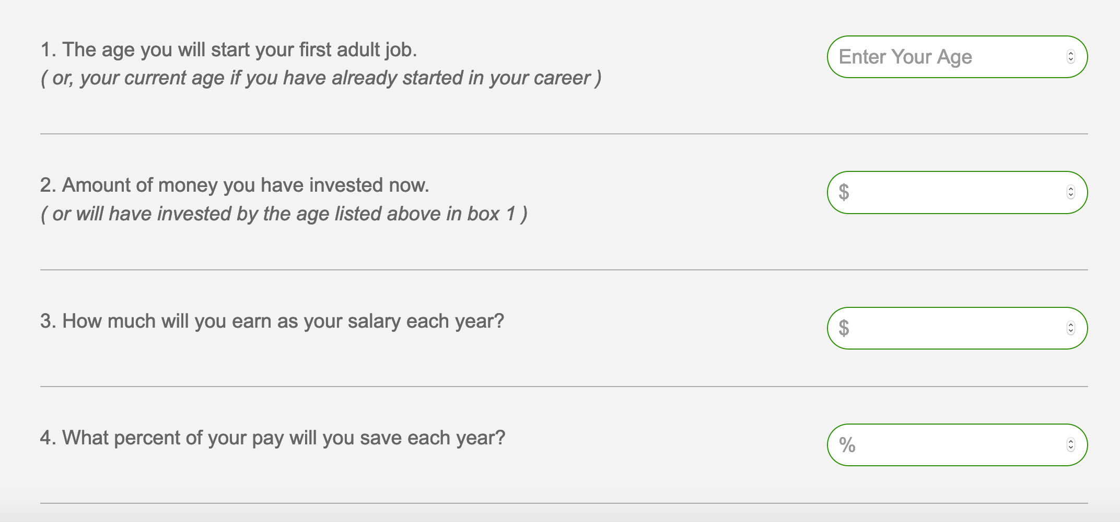
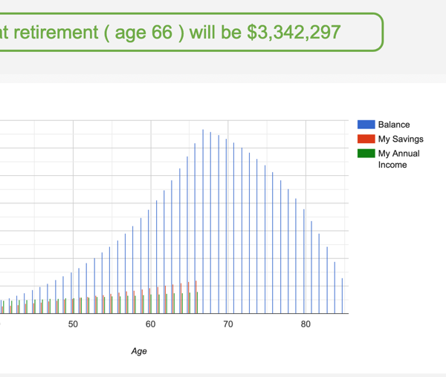

Workshop intentional-investment.com

Slide 33

Case study: Primary Care Physician
Dr. A Age 32 $0 Saved $200,000 Salary $6% Deferred Match = 50% up to 6% of salary Goal: 7% investment return Retirement Age 66 Investment Return After Retirement: 6% Percent of income replaced: 60%

Slide 34

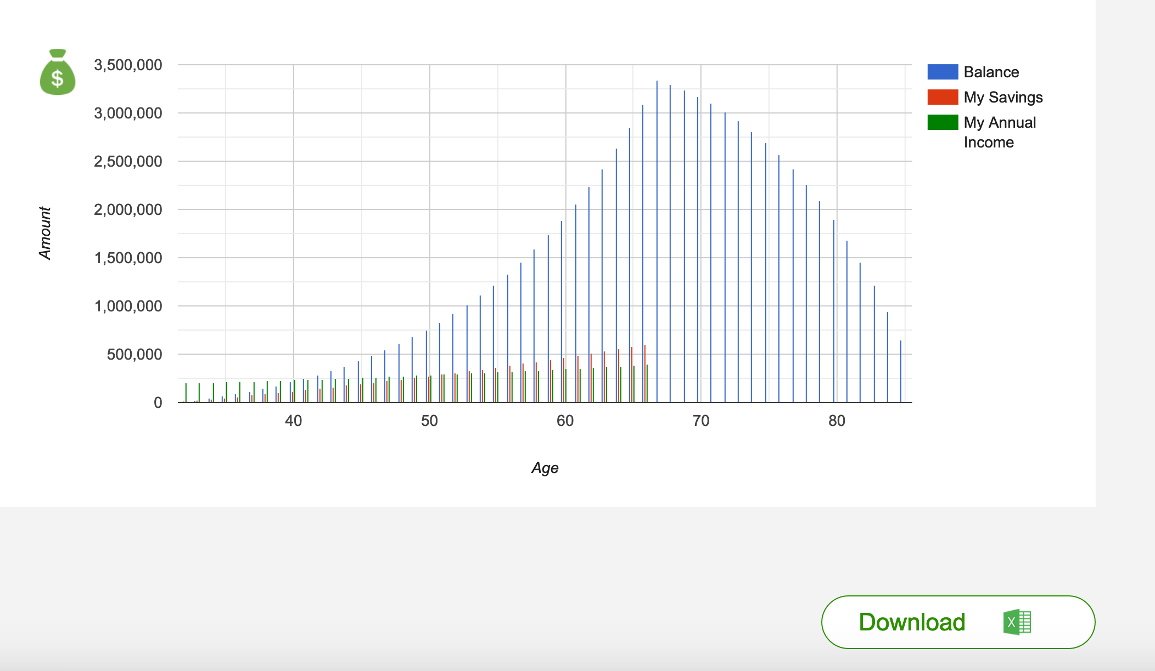

Slide 35
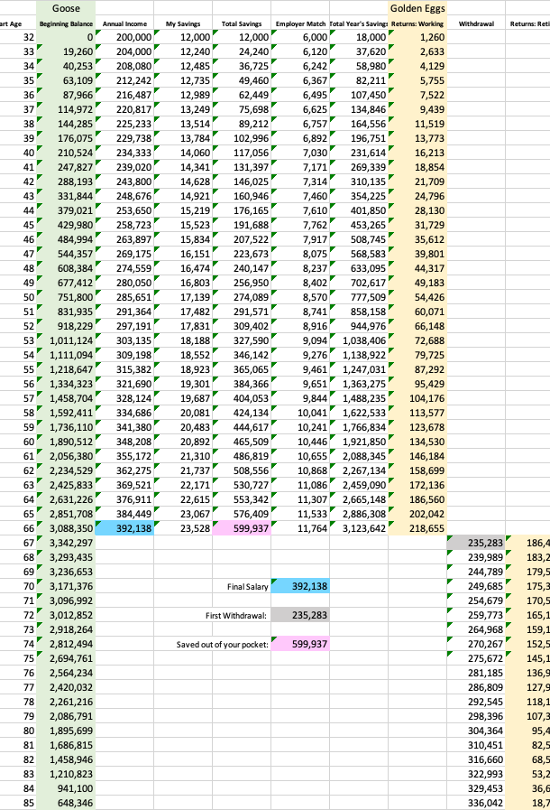
CONGRATULATIONS,
YOU ARE ON TRACK
$3.3M at 66 $331,000 at 86

Slide 36

Case Study: Specialist
Dr. B Age 35 $0 Saved $400,000 Salary $6% Deferred Match = 50% up to 6% of salary Goal: 7% investment return Retirement Age 66 Investment Return After Retirement: 6% Percent of income replaced: 60%
This Photo by Unknown Author is licensed under CC BY

Slide 37
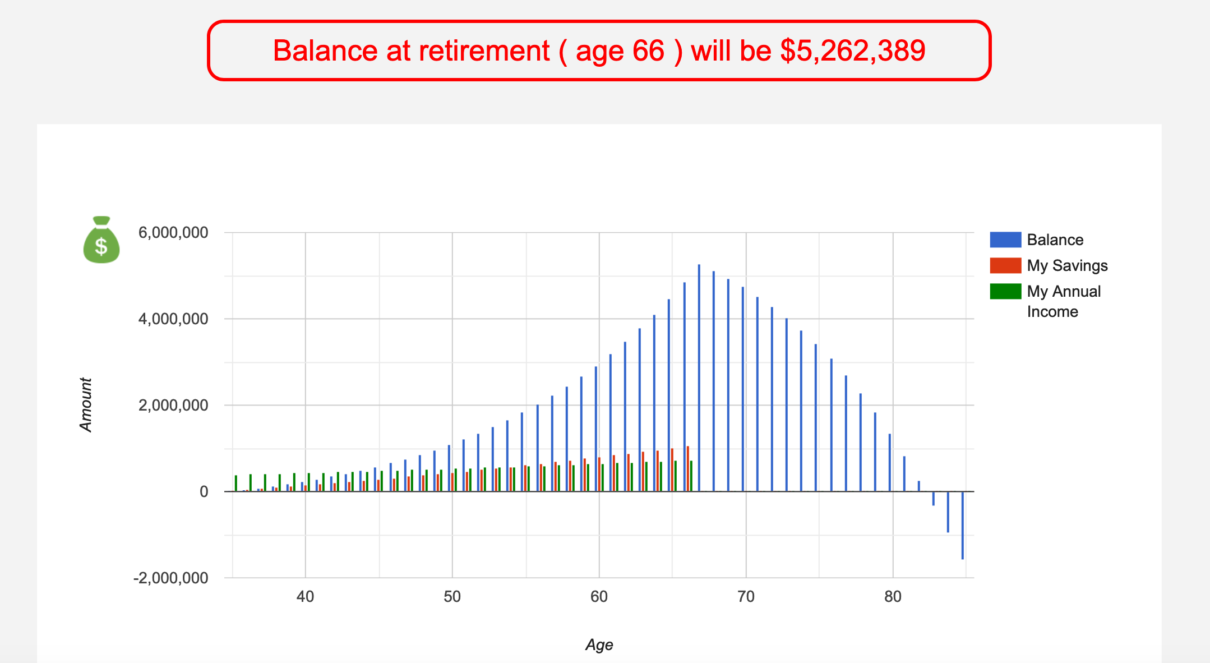
Dr B’s Results: $5.2 million in assets Still about $1 million short at 85

Slide 38
Three things Dr. B could do:
Defer more
8% deferred $6.4 million @ 66
Work longer
Retire 68 $6.1 million
Live on less
Live on 50% of income $5.2 million (withdrawing less)

Slide 39

INFLATION

Slide 40
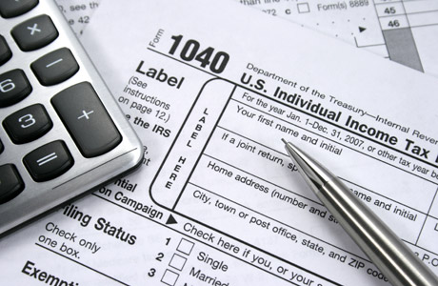
TAXES

Slide 41

Federal Tax Bracket Lesson
Flier: 2020 Tax Brackets
Income Tax Brackets ~ stair steps
2020 Marginal Tax Bracket Schedule
37%
35%
32%
24%
22%
12%
10%
Notes:
39.6% was highest bracket rate in 2017 before law changed under Trump
Highest in history was 1944-1955, when 94% tax rate was applied to income above $200k ($2.4M in current dollars)
Apply this to a Roth 401k plan…

Slide 42
State Tax Lesson
Flat Tax
IL: 4.95%
IN: 3.23%
No State income tax:
Alaska, Wyoming, South Dakota, Texas, Florida, Washington, Nevada
Notes:
39.6% was highest bracket rate in 2017 before law changed under Trump
Highest in history was 1944-1955, when 94% tax rate was applied to income above $200k ($2.4M in current dollars)
Apply this to a Roth 401k plan…

Slide 43
Sidebar: Tax Lesson
Three times you can get a tax advantage
Pre-Tax
Contribution
Tax Deferred
Growth
Tax Free
Withdrawal

Slide 44

RISK VS RETURN

Slide 45
Risk vs. Return
The chance your investment will increase or decrease in value
The financial reward
you gain from the
investment

Slide 46

Three main asset classes:
Stocks = ownership
Bonds = ‘loanership’
Cash = capital preservation

Slide 47









Equity/Ownership in a company
CMG
What is a stock?
MSFT
DNKN
NFLX
AAPL
LB
AMZN
GE
DIS
Notes:
Of all the asset classes, stocks have the potential for the highest returns over time. For long-term investors, stocks are often a significant part of their portfolios. However, stocks are considered the riskiest investment asset class. Their unpredictable movement up and down in value is called volatility, and this volatility translates into what the value of the money you invest in stocks will likely do—go up and down, too.
So stock, or “equity,” securities are offered by companies and then traded on secondary exchanges, such as the NYSE or NASDAQ exchange.
When you buy a stock, you become part owner of the company (you have “equity”) and share in its profits and losses. Stock mutual funds, such as those offered in most voluntary retirement plans, hold stocks in many different companies.
Some stocks, typically of established companies, pay dividends to their shareholders. A dividend is a payment to you that represents your share of the company’s earnings that are available for distribution. Instead of keeping the profits, the company spreads the profits among its stockowners or shareholders. Smaller, less established companies often prefer to reinvest their earnings in the business. High technology companies, for example, frequently do not pay dividends for this reason.

Slide 48
How do I make money in stocks?
1. Appreciation of stock price 2. Dividends: company pays a portion of it’s profits

Slide 49
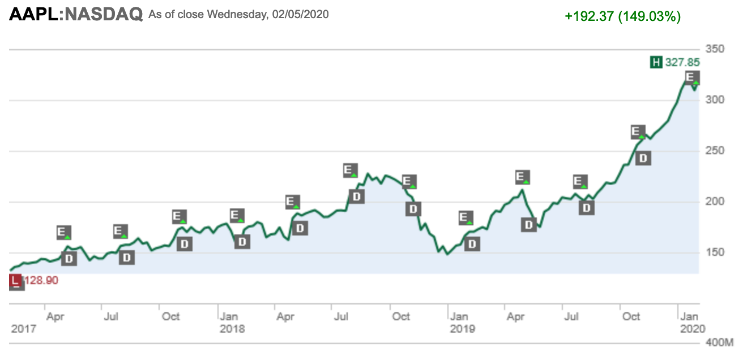
Apple Stock: Appreciation of stock price
February 2020
$327.85
$ 327.85
-$ 128.90 $ 198.95
(Capital Gain)
Feb 2017
$128.90
Source: Schwab.com

Slide 50
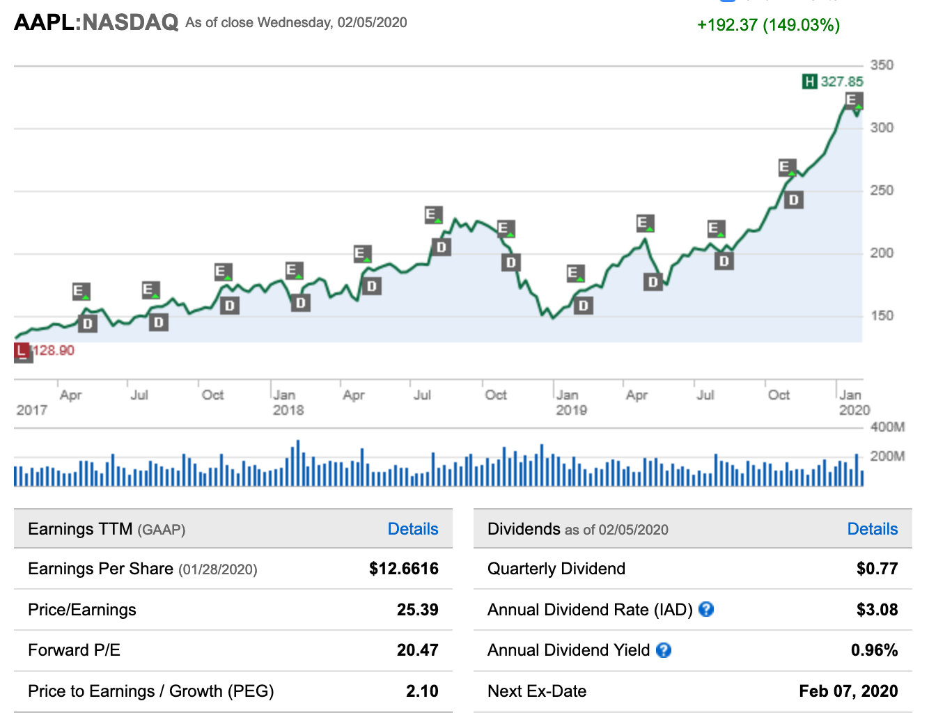
Apple Stock: Dividends
Stock Price
$327.85
x
Annual Dividend Yield 0.96% =
$3.15 annual dividend
Source: Schwab.com

Slide 51

What is a bond?

Slide 52
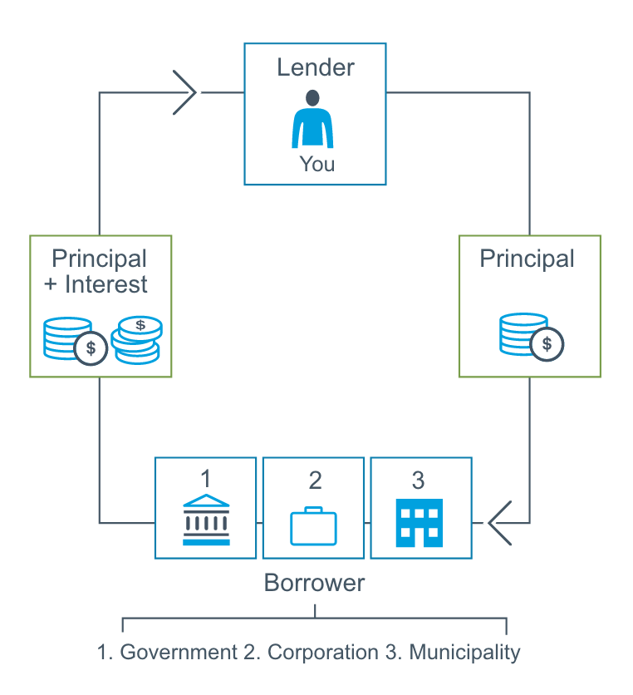
The bond cycle

Slide 53
Bond Example: Apple Inc.
$10,000
Bond Face Value, 5 year term
5%
Bond Interest (coupon) rate
$500 Annual Interest Payment
+
=
You get your $10,000 back after 5 years

Slide 54
What is a cash investment?

Slide 55

Cash Investments- Interest
Bank account interest
CDs
Money Market Fund

Slide 56
Risk vs. Return Potential Continuum
Lower Risk/Return Higher Risk/Return
Cash Govn’t Corporate Large Small/Medium International
Bonds Bonds Stocks Stocks Stocks

Slide 57

What is an Index?
Sample that represents the whole market
Used to track performance of stock market
Examples:
Dow Jones (DJIA)
S&P 500, S&P 400
Russell 2000

Slide 58
Growth of $1000
1995-2019
$12,447
$11,045
$6,697
$3,875
$1,728
$1,699

Slide 59

Target Date Fund
Birthday Year + 65 = Target Date Year
1991 + 65 = 2056
Target Date 2055 Fund

Slide 60
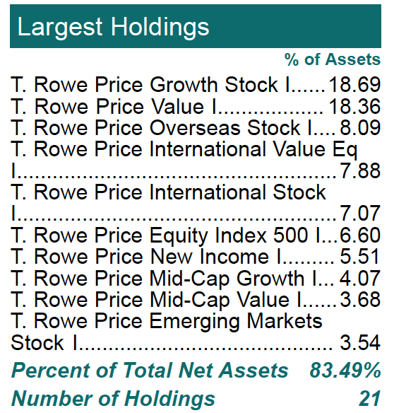
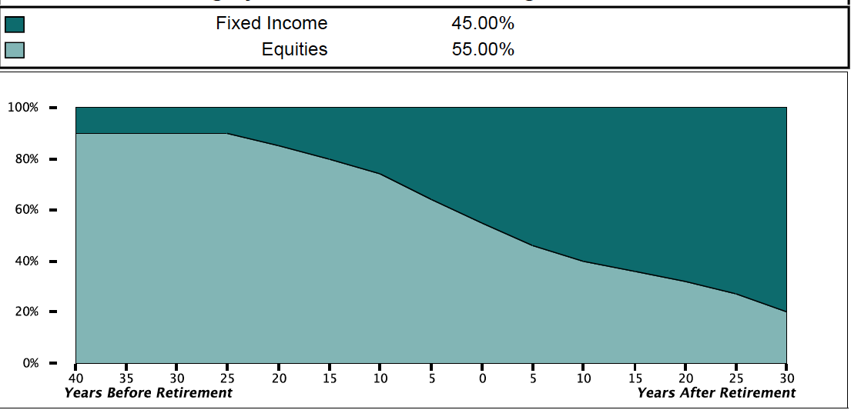
TARGET DATE FUND – RISK REDUCTION PATH

Slide 61

Diversification: Rule of 120
120 – Your Age = Percentage of Equity Investments
120 – age 30 = 90% equity 10% fixed income
120 – age 60 = 60% equity 40% fixed income
Compare to Target Date Fund chart

Slide 62

PLAN TYPES
401(K), 403(B), 457(B)

Slide 63
EMPLOYER PLANS
401K—403B—457B
PRE TAX
GROWS TAX DEFERRED
$19,500 MAX IN 2020
INVEST IN MUTUAL FUNDS
TAXED AT WITHDRAWAL MATCH…

Slide 64
EMPLOYER PLANS
401K—403B—457B
PRE TAX
GROWS TAX DEFERRED
$19,500 MAX IN 2020
INVEST IN MUTUAL FUNDS
TAXED AT WITHDRAWAL MATCH…

Slide 65

Employer Match
Employer match = free money
Incentive for you to save
Most common match formula-
50% up to the first 6% you contribute
National average: 3.27% of salary

Slide 67

Match Formula Example
Example: 50% match up to 6% of salary deferred
$200,000 per year salary
$200,000 x 6% = $12,000 you contribute per year

Slide 68
Match Formula Example:
$12,000 / 26 paychecks = $461.54
BUT only miss $350.76 because of 24% federal tax bracket
$461.54 deferral
+$230.77 match
$ 692.31 total contribution per pay period
VESTING

Slide 69




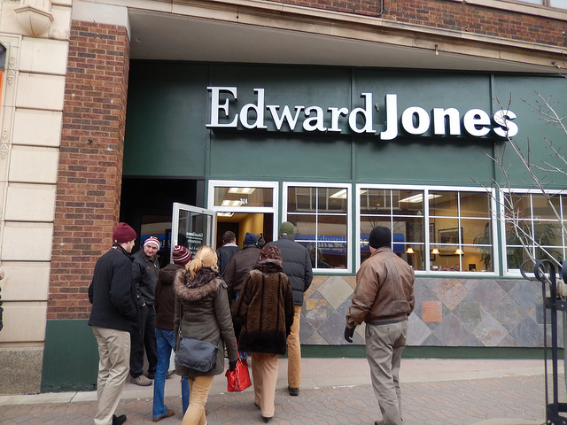
INDIVIDUAL SAVINGS VEHICLES
IRA- TRADITIONAL OR ROTH
$6000 IN 2020
BROKERAGE
NO TAX ADVANTAGE, NO LIMITS

Slide 70

LIFE INSURANCE
PROTECTION, NOT INVESTMENT

Slide 71

LIFE INSURANCE
Income replacement
Or
Labor Replacement

Slide 72

TERM LIFE vs. WHOLE LIFE
Date this policy: In force for a specific time (20 years)
Expires
No cash value
Inexpensive
Marry this policy: till death do us part, expensive to get out
Pays benefit at death
Accumulates cash value
10x-30x more expensive than term

Slide 73
Case Study
30 year old female in excellent health
$1million death benefit
TERM | WHOLE LIFE
TERM: 25 YEARS | PAYS FOR LIFE
PROTECTIVE LIFE PREMIUM: $432 ANNUALLY | NW MUTUAL PREMIUM: $11,998 ANNUALLY
10 YEARS PAY IN: $4320 | 10 YEARS PAY IN: $143,976
QUIT/CASHOUT IN 10 YEARS: $0 RETURNED | QUIT/CASHOUT IN 10 YEARS: LESS THAN $100,000 RETURNED
This Photo by Unknown Author is licensed under CC BY

Slide 74
Whole Life Insurance: After you have…
Paid off all consumer debt $ 1,000
Paid off student loans $200,000
Max deferral: 401(k), 403(b), 457(b) $19,000-$38,000
Health Savings Account $7,000
Kid’s college 529 plans fully funded $15,000-$30,000
Backdoor Roth for you and spouse $12,000
$1M-$3M term insurance +$1,500
Per year: $54,500-88,500

Slide 75
Life Insurance: More efficient vehicles
Life Insurance
Term
College Savings
529 Plan
Retirement Savings
401k/403b/IRA/Roth

Slide 76

WILLS/TRUSTS

Slide 77
WILL
TRUST
HEALTH CARE POWER OF ATTORNEY

Slide 78
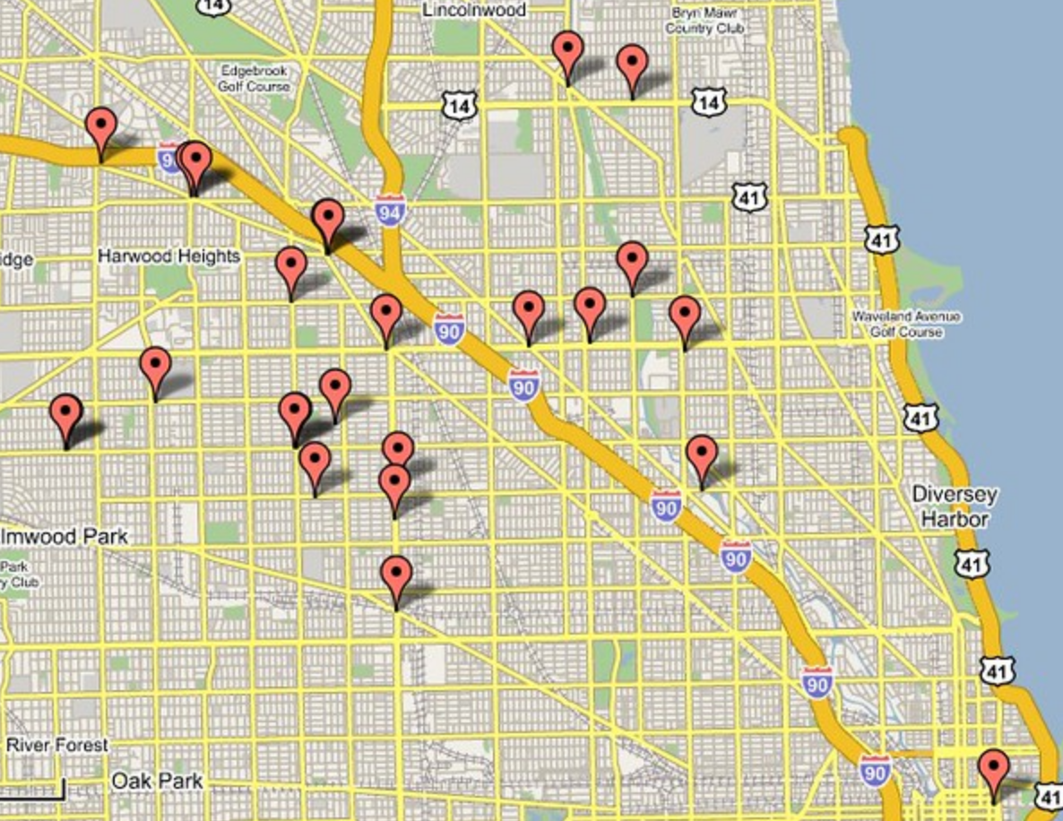
ROADMAP

Slide 79
LIVE LIKE A RESIDENT RESIDENT 2.0 - 3.0
RESIDENT 2.0 IN ATTENDING YEARS 1, 2, 3
$50,000 x 2 = $100,000
RESIDENT 3.0 IN ATTENDING YEARS 4,5
$50,000 x 2 = $150,000

Slide 80
CASE STUDY $200,000 Salary $200,000 Loans
Year | Salary | Living Expenses | Debt Service | Net debt reduction | Wealth Accumulation
0 | $50,000 | $48,000 | 0 |  | $2,000
1 | $200,000 | $100,000 (R2.0) | $80,000 | ($64,000) | $20,000
2 | $200,000 | $100,000 (R2.0) | $80,000 | ($64,000) | $20,000
3 | $200,000 | $100,000 (R2.0) | $40,000 | ($32,000) | $60,000
4 | $200,000 | $150,000 (R3.0) | $30,000 | ($24,000) | $20,000
5 | $200,000 | $150,000 (R3.0) | $30,000 | ($24,000) | $20,000
TOTALS |  |  |  | ($208,000) | ($115,000)-$142,000
Amounts not in parentheses are shown on a pre tax basis for illustration purposes
Notes:
Never live on all of your salary.
Live below your means
Live on 50% of your income for 2-3 years
Live on 75% of your income until debt is paid off and house down payment secured
This example shows growing into 83% of your salary, and saving 17% each year.

Slide 81
Financial Priority Roadmap:
Emergency Fund
Get match in your 401(k)/403(b) plan
(Roth or debt payment if no match)
Pay off high-interest debt (rates 7%+)
Fund HSA if eligible
THEN…

Slide 82
Financial Priority List Continued
Student Loans
(4-7%)
House
Down Payment
College
Savings
(529)
Backdoor Roth
(self)
Backdoor Roth
(spouse)
White Coat Investor, See Chapter 6

Slide 83
Parting Thoughts From Some Favorite Physicians…
Choose your spouse well
Start saving in residency
Pay down your debts fast and hard
Learn a basic amount of personal finance
Obtain your disability insurance before you officially sign your contract
Never fully grow into your salary

Slide 84
Every day of your life you are on the verge of making slight changes that would make all the difference.
Mignon McLaughlin

